Slide 1
E-Commerce Customer Churn Analysis and Prediction
By: Priyanka Bagchi
Priyanka.Bagchi.pb@gmail.com
Supervisor: Dr. Sedef Akinli Kocak, PhD
sedef.akinlikocak@ryerson.ca

Slide 2
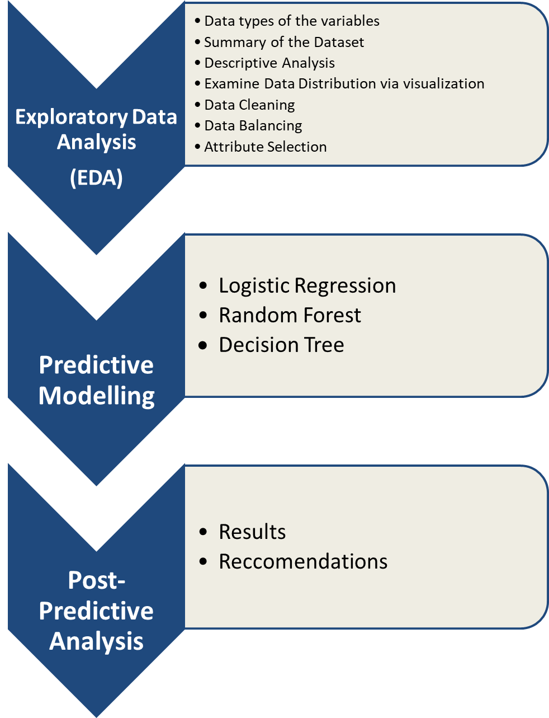
Approach
Step 1: Exploratory Data Analysis (EDA)
Step 2: Predictive Modelling
Step 3: Post-Predictive Analysis

Slide 3
Step 1: Exploratory Data Analysis (EDA)

Slide 4
Data types of the Variables
Summary of the Dataset
Examine Data Distribution
Density plots to see the Distribution of all the Variables
Frequency table of all the columns that have character data types
Total number of missing values in each column
Data Cleaning: Character Variables
Data Cleaning: Numeric Variables
Density plots to see the Distribution of all the Variables after Cleaning
Correlation Between all Numerical Variables
Feature Selection

Slide 5
Step 2: Predictive Modelling

Slide 6
The 3 Machine Learning Models Used
After reviewing multiple journal articles during the literature review these are the 3 models that were chosen:
Logistic Regression
Random Forest
Decision Tree

Slide 7
Metrics used to Evaluate the 3 Models
As per the literature review, these are some of the best evaluation metrics to use for a dataset with an imbalanced target class:
ROC
AUC
F1
Sensitivity
Specificity

Slide 8
Step 3: Post-Predictive Analysis

Slide 9
Results

Slide 10
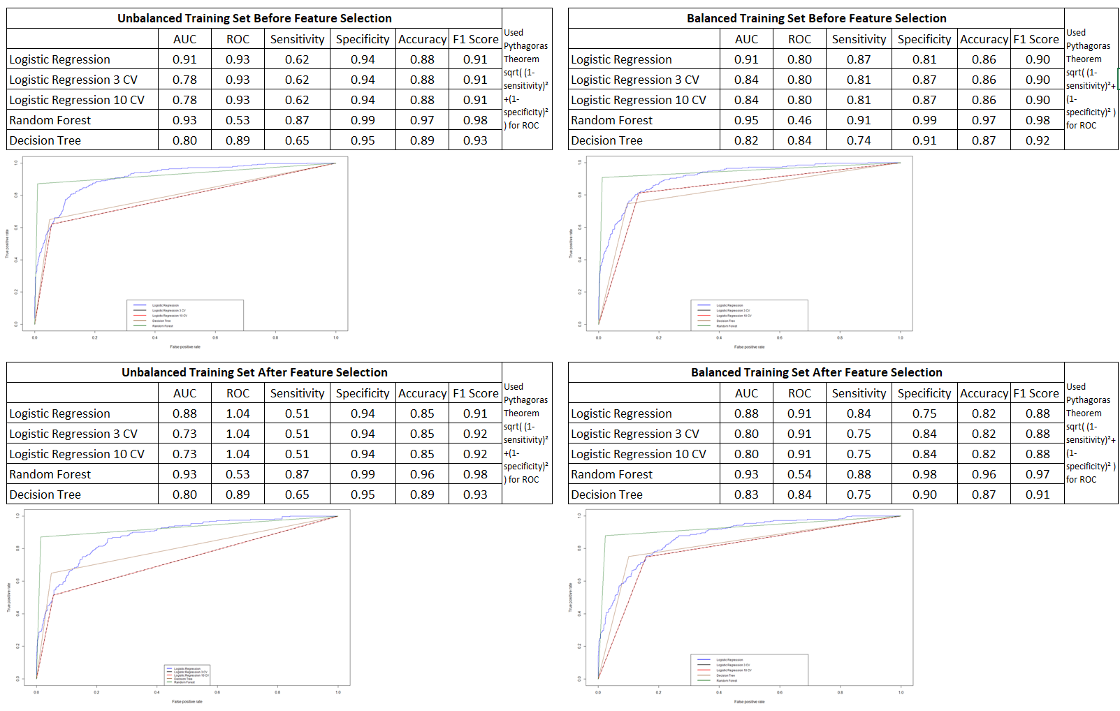

Slide 11
Recommendations
Continue to collect more data. This will help with the overfitting issue and improve the performance of all the models.
If they still want to use the current predictions, the top 8 variables to keep in mind would be:
Tenure
OrderCount
Complain
NumberOfAddress
CashbackAmount
DaySinceLastOrder
NumberOfDeviceRegistered
WarehouseToHome

Slide 12
Limitations
Relatively small dataset
Due to time restrictions and the scope of this course:
The planned use of the XGBoost model was replaced with Decision Tree
Simple oversampling used instead of Safe-Level-SMOTE
Automatic feature selection method and Variable Importance from Machine Learning Algorithms, Recursive Feature Elimination (RFE) used instead of Step wise Forward and Backward Selection

Slide 13
Thank You!

